Slide 1
EFI™ Fiery® eXpress 4.6
Product Overview
September 2016

Slide 2
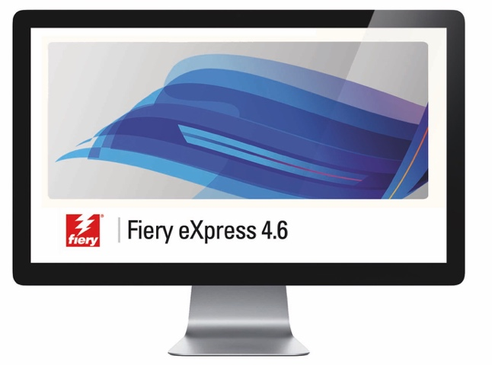
Content
Introduction to EFI Fiery eXpress
Target markets and user profiles
Key features
What’s new in Fiery eXpress 4.6
Sales and marketing information

Slide 3
Introduction to Fiery eXpress
Print, proof, verify….

Slide 4
Fiery eXpress - introduction
Fiery eXpress is…
an entry level RIP and color management workflow
very comprehensive, yet intuitive
productive and highly automatable
easy to install, set-up, and operate
color ready out-of-the-box
for inkjet, laser and LED technologies
100% focused on standards
perfect for hybrid environments; print, proof, verify….

Slide 5
Fiery eXpress - introduction
Foundations
Cross platform, Windows and Mac OS X support
Adobe PostScript and APPE
Multi-language support
English (US+UK), French, Italian, German, Spanish, Japanese, Chinese and Polish
Two sizes, Small (up to 18”/A2) and Large (24” and larger)
Open ICC color management
Halftone, Contone and RGB drivers
Desktop application, with server functionality
Continuous tone technology
Single workflow or print queue
From the same core high-end technology as EFI Fiery XF

Slide 6
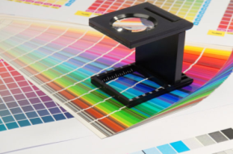
Fiery eXpress – target markets
Production print
E.g. agencies, designers, print-for-pay, commercial printers
With a need for high quality poster or production printing, and spot color simulations
Standardized proofing
E.g. repro suppliers, production houses, commercial photographers, agencies and designers
With a need for contract proofs, production with process control or job verification, and optimization
Photography and image reproduction
E.g. photographers, art printers
With a need for reliable output from image file formats onto chosen medias

Slide 7
Key features

Slide 8
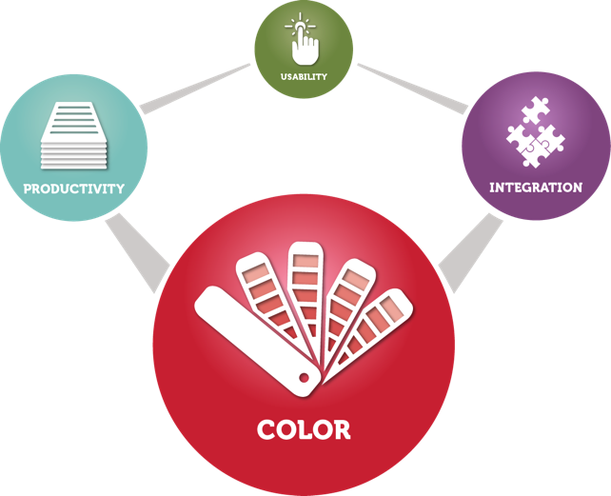
Color

Slide 9
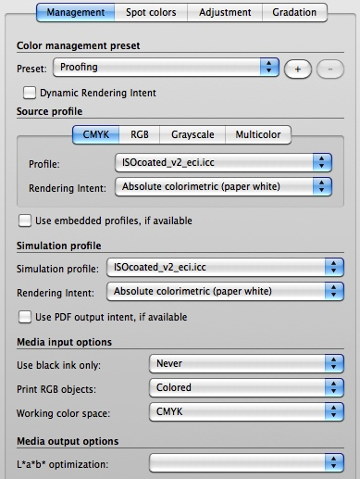
Color – ICC technology
Over 2500 built-in ICC profiles for over 400 printers
Latest ISO profile support
CMYK, RGB, Grayscale and Multi-channel profile support
Custom profile support
Support for L*a*b* optimizations
Expert level color controls, and ease of use!

Slide 10
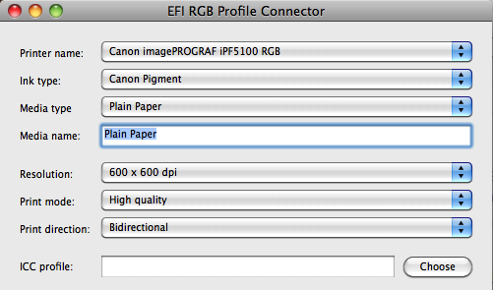
Color – ICC technology cont.
Dynamic Rendering Intent for automatic best results
RGB Profile Connector for “off the shelf” profile use
Control over working color space, black control and more
Expert level color controls, and ease of use!

Slide 11
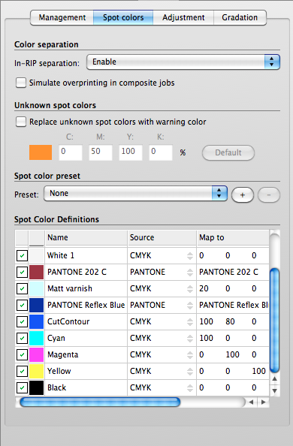
Color – spot colors
PANTONE®, PANTONE® Plus, HKS®, DIC and Toyo libraries
Custom spot color support
Spot color editing
Unknown spot color detection and warning
Right-first-time tools, control when you need it!

Slide 12
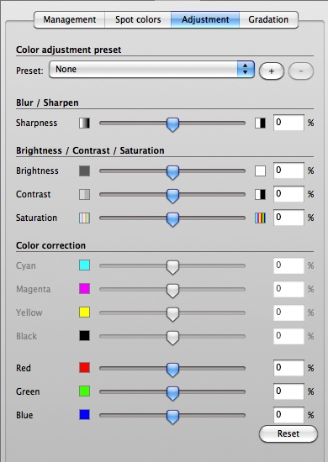
Color – adjustments
Sliders for sharpness, brightness, contrast and saturation
Color corrections for RGB or CMYK files
Gradation curve editing
Conversion to chosen grayscale from any format
Intuitive late editing for single or batches of files!

Slide 13
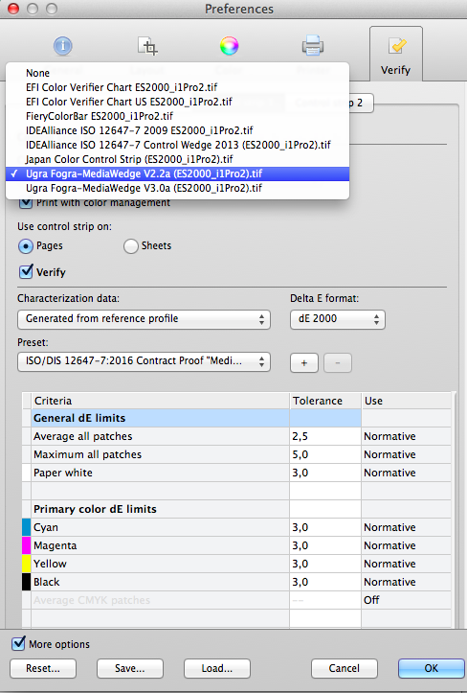
Color – verification
Latest Fogra, Idealliance, Japan Color and EFI control wedges
Automatic or manual verification
Optional second control wedge
Job-based optimization
Customizable tolerances
Summary and optional label print
Process control for all customer types and applications!

Slide 14
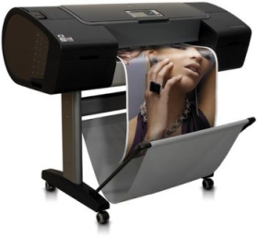
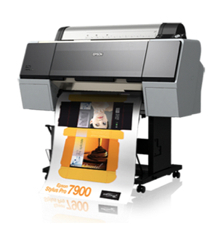
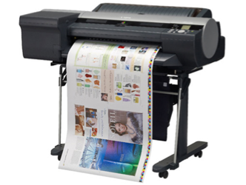
Integration – measuring devices
EFI ES-1000, ES-2000, X-Rite i1Pro & X-Rite i1Pro 2
Manual verification and optimization
EFI’s ES-2000 and X-Rites i1Pro 2 will work with Fiery eXpress in M0 mode only!
HP Designjet Z Embedded
Automatic verification and optimization
Epson SpectroProofer ILS20
Automatic verification and optimization
Canon Spectrophotometer
Automatic verification and optimization

Slide 15
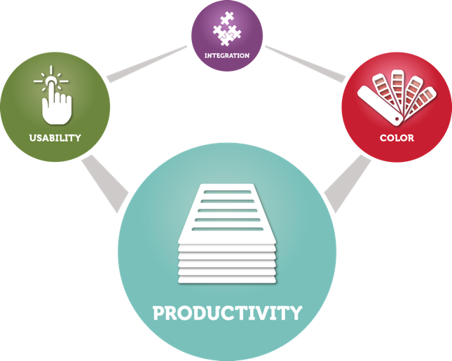
Productivity

Slide 16
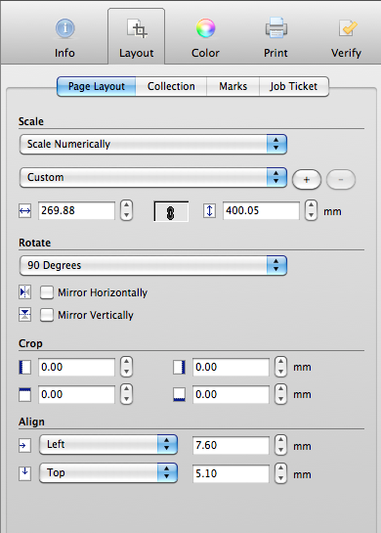
Productivity – layout functions
Page Layout
Uniform or non-uniform scaling by media size, percentage or numerically
Rotate by 90º increments, or flip horizontally or vertically
Crop manually or numerically
Align or position manually or numerically
Guides and adjustable zero point origin
Design software-like tools for a familiar look and feel!

Slide 17
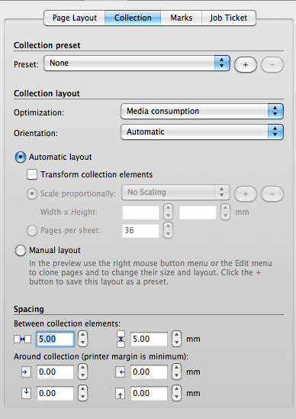
Productivity – layout functions
Collections
Clone single or mix multiple pages
Make contact sheets or nests from predefined presets
Define and save custom collection presets
Position and orient pages for optimal media use or cutting
Space pages manually or numerically
Transform all pages in one collection
Easy contact sheets, photo books, and media saving!

Slide 18
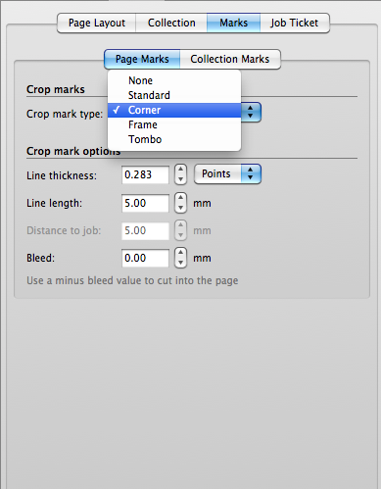
Productivity – layout functions
Marks
Page Marks or Collection Marks, choose from Standard, Corner, Frame or Tombo
Control Line thickness, Length, Distance to job and Bleed in cm, mm, Inches or Points
Flexibly crop marks and bleed, whatever the file type!

Slide 19
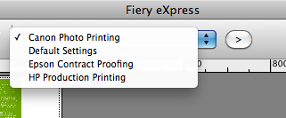
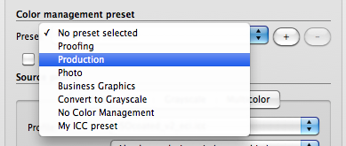
Productivity – presets
Saveable and loadable presets
For global settings, workflows, color management, color adjustments and collections
Automate frequent tasks, switch global settings in one click!

Slide 20
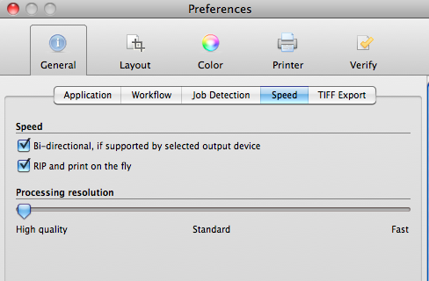
Productivity – speed setting
Speed
Select bi-directional, RIP and print on the fly, or a suitable Processing resolution
Maximise throughput with speed settings for your specific printer and job types!

Slide 21
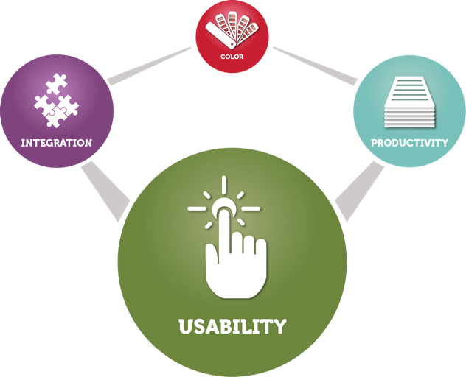
Usability

Slide 22
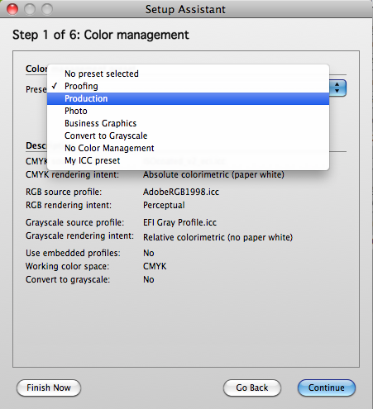
Usability – wizards
Wizards for:
Activation
Set-up
Configuration
Job verification
Users are guided to the most suitable setup, or next step for optimal results!

Slide 23
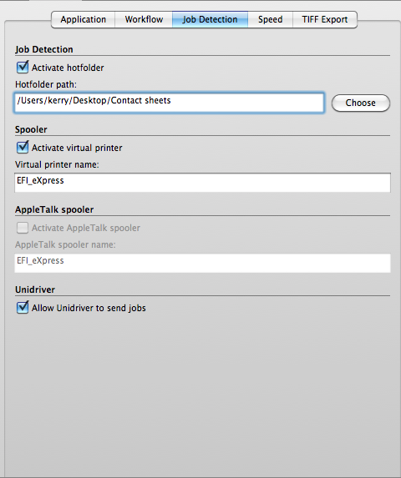
Usability – job submission
6 ways to import jobs:
Unidriver
Hotfolders
Virtual printer
AppleTalk spooler
Drag-and-drop
Manual import
Print options for your environment, workflow or preference!

Slide 24
Usability – file format support
18 file format options:
PS, EPS, PDF, DCS1, DCS2
PDF/X-1, PDF/X-1a, PDF/X-3
RPF
TIFF, JPEG
PSD, JPEG2000, Image EPS, Image PDF, RAW
With EXIF data support
Same color and production controls, regardless of the file format!

Slide 25
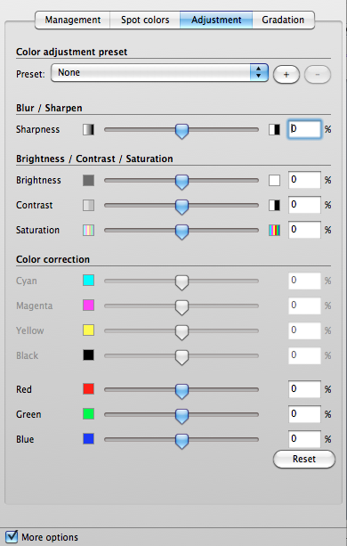
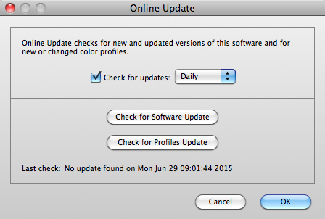
Usability – general
“Everyday” work mode for a simpler interface
Manual or automatic Online Update checker
Backup and restore settings and jobs; for Fiery eXpress or Fiery XF
Spend more time producing and less time administering!

Slide 26
What’s new?

Slide 27
What’s new in Fiery eXpress 4.6
A single Fiery eXpress
Fiery eXpress for Photo, Proofing and Proofing Advanced products are replaced by a single product
Users buying a full version, or an upgrade, now benefit from the complete toolset of all the three previous offerings
Two sizes
Fiery eXpress 4.6 Small: up to 18”/A2
Fiery eXpress 4.6 Large: 24” and larger

Slide 28
What’s new in EFI Fiery eXpress 4.6
And
Support for the latest ISO 12647-2 reference profiles
Updated verification presets for proof validation in compliance with ISO/DIS 12647-7:2016
Support for the latest PANTONE® spot color libraries
Support for the EFI ES-2000 and X-Rite i1Pro 2 spectrophotometers
14 new printer drivers for EPSON and Canon devices
Mac OS X 10.11, 10.12 and Microsoft® Windows® 10 support
See release notes for more details: efi.com/fieryexpress

Slide 29
Sales and marketing information

Slide 30
Minimum system requirements
Hardware requirements
Microsoft® Windows® 2 GHz Pentium IV PC/Macintosh with Intel CPU, 1024 MB Ram, 10/100 Mbit Network, 1 available USB port
Operating system requirements
Microsoft® Windows® 7, 8, 8.1 and 10
Mac OS X 10.9, 10.10, 10.11 and 10.12

Slide 31
Fiery eXpress - pricing
Fiery eXpress 4.6 Small
For printers up to 18”/A2
EUR 600.00 / USD 750,00 / GBP 510
Fiery eXpress 4.6 Large
For printers of 24” and larger
EUR 1.000,00 / USD 1.250,00 / GBP 850

Slide 32
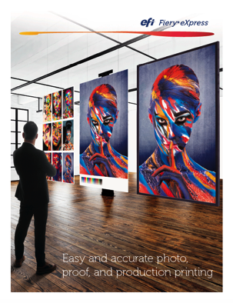
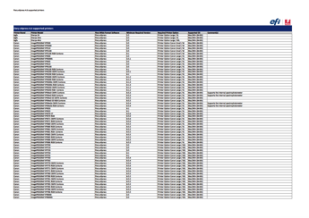
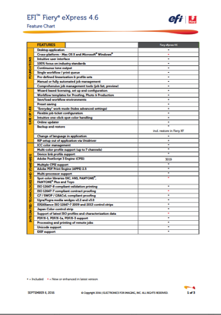
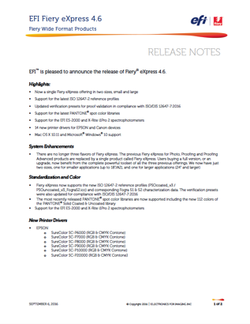
Fiery eXpress – marketing materials
efi.com/fieryexpress
Brochure
Feature Chart
Supported Printer List
Release Notes
Gold and Fiery Partner Portal
Overview Presentation
Known Issues

Slide 33
Thank you

